Slide 1

MINI PROJECT TOPIC : Landscape generator

Slide 2
GROUP MEMBERS
YASH DESAI [ A-35 ]
HARSH PATIL [ A-36 ]
AMOL MORE [ A-37 ]
SHIVRAJ PATIL [ A-40 ]

Slide 3
INTRODUCTION
We are working on a computer game for generating a realistic landscape.
Our algorithm inspires by geological processes.
Firstly, we have started our algorithm by generating a simple flat landscape.
It modifies ups and downs of landscapes repeatedly.

Slide 4
OBJECTIVES
To generate a realistic landscape for a computer game.
To interpret any sequence of such modifications like the lifting or lowering landscape outputs .
The goal is to calculate the result height of every position of line.

Slide 5
METHODOLOGY
The below flowchart shows the methodology of the landscape generator:

Slide 6
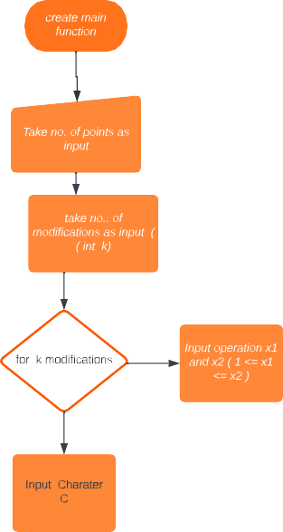

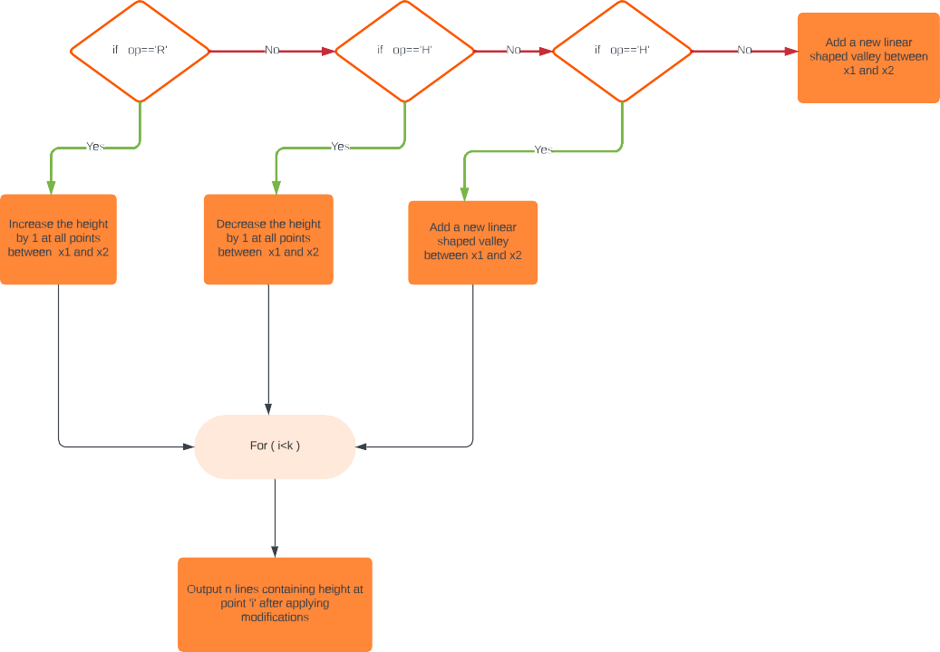

Slide 7

TECHNOLOGY DESCRIPTION
We are implementing this problem statement with the help of c++ Language

Slide 8
REQUIREMENTS
Software requirements:
C++ compiler
Hardware requirement:
Processor Intel i3/i5/i7
RAM minimum 4 GB
Hard disk minimum 15 GB
System type 32bit Operating System
Internet connection

Slide 9
LITREATURE SURVEY
C++ Basic Concepts
https://www.javatpoint.com/cpp-tutorial
Landscape Generator
https://www.youtube.com/watch?v=B6yNhtNehE0

Slide 10
REFERENCE
https://icpc.global/worldfinals/problems/2020+ACM-ICPC+World+Finals/icpc2020.pdf
https://www.youtube.com/watch?v=B6yNhtNehE0

Slide 11
Thank You

